Slide 1

Computer Vision in Python Course Introduction
Matthieu De Mari

Slide 2

A quick word about instructors
Matthieu (Matt) De Mari
Director (Master of Science in Design and Artificial Intelligence for Enterprise)
Senior Lecturer at SUTD (Python, Deep Learning, Prog. Language Concepts, Capstone, etc.)
PhD from CentraleSupelec (France)
Email: matthieu_demari@sutd.edu.sg
Office @ SUTD (in SUTD Academy/AI cluster): 2.401-07.

Slide 3
Objectives of this course
Introduce the technical aspects related to the implementation of Deep Neural Networks, a.k.a. Deep Learning.
Teach the students about the most popular framework for implementing Deep Neural Networks (as of Jan 2025): PyTorch.
Discuss the mathematical foundations and intuitions behind Deep Learning tools, layers and techniques.
Give the students a global overview of the foundational and advanced techniques related to Deep Learning and Neural Networks.
Describe examples of practical applications of Deep Learning, showing how some key AI tools are implemented.

Slide 4
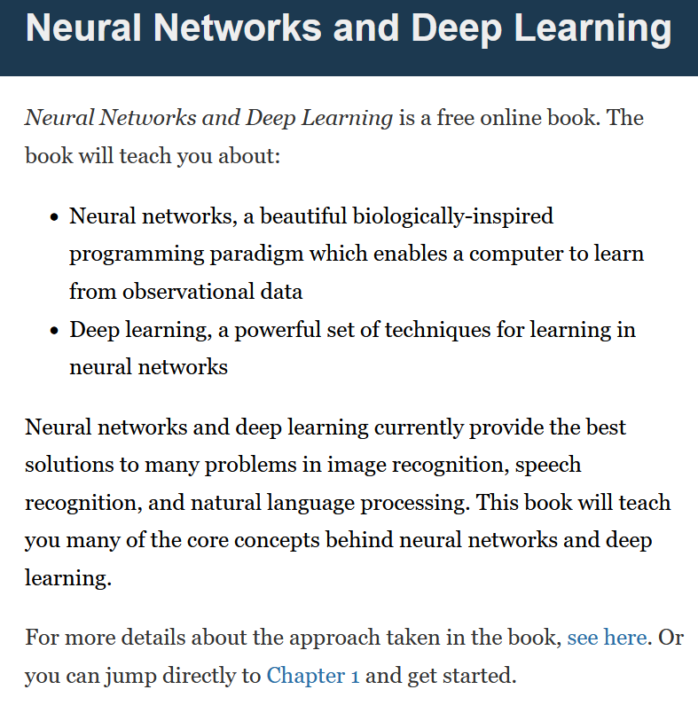
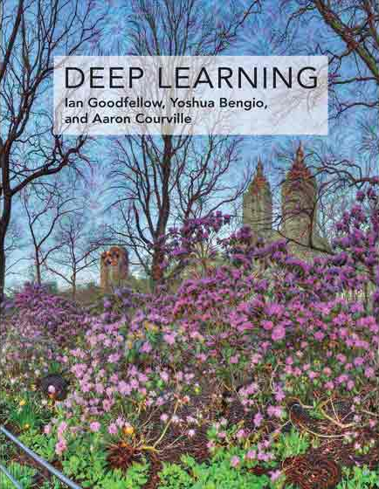

Supporting Textbooks
Supporting textbooks, for your curiosity (not needed to understand this course, just for reference).
Michael A. Nielsen, “Neural networks and deep learning”, 2015. (http://neuralnetworksanddeeplearning.com/)
Ian Goodfellow, Yoshua Bengio and Aaron Courville, “Deep learning”, 2016. (https://www.deeplearningbook.org/)
Stevens et al., “Deep Learning with PyTorch”, 2020. (https://www.manning.com/books/deep-learning-with-pytorch)

Slide 5
Evaluation and grading
Quiz at the end of Day 1 and Day 2 (30%): Simple MCQ to be taken online, after each day.
Project, to be announced today and delivered on Day 4 (60%): A more technical implementation of the concepts seen in class on a real-life problem.
Participation and Attendance (10%): Not punishing, as long as you attend classes, you should be fine!

Slide 6



Technical pre-requisites
Install Python 3, if you have not done so already (this course does use the C++/Java version of PyTorch).
Libraries needed (maybe more based on projects/homeworks): numpy, matplotlib, scipy, sklearn, torch, torchvision, torchmetrics, possibly more.
Jupyter notebooks for demos of code, along with the slides.
In doubt, you can always use Google Colab to run the codes.

Slide 7

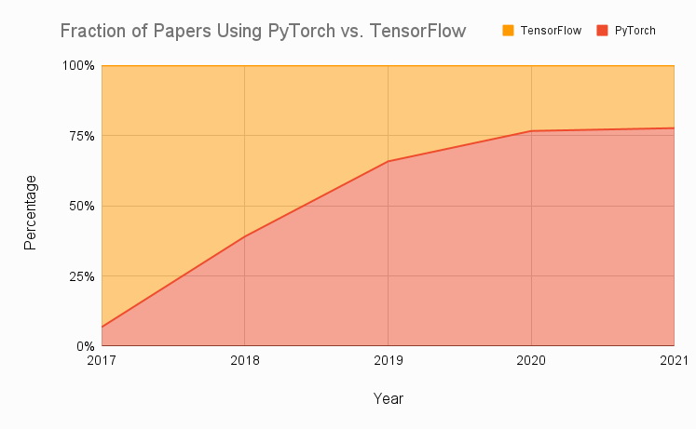
Technical pre-requisites
Framework of choice will be PyTorch! (not Tensorflow, not Keras, not MXNet, etc.)
Increasing popularity and preferred to Google’s Tensorflow these days for many reasons.
Learn more, if curious: https://www.assemblyai.com/blog/pytorch-vs-tensorflow-in-2022/
Also, this: https://arxiv.org/abs/2508.04035

Slide 8
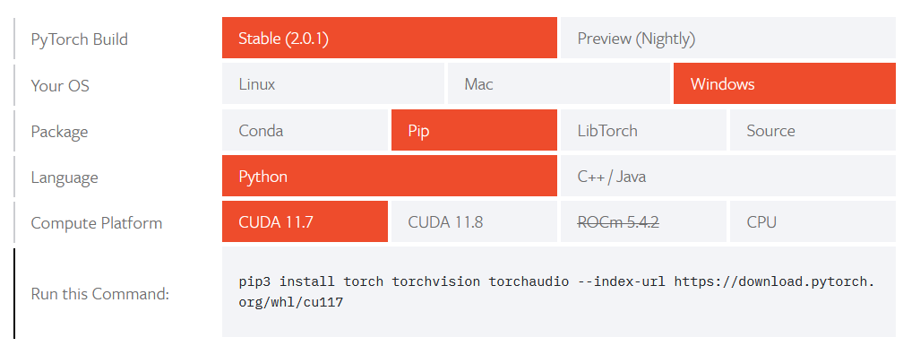
Installing PyTorch and CUDA
Install PyTorch, by getting the latest version (not the one shown below!) from https://pytorch.org/get-started/locally/
Setting up CUDA/GPU acceleration is always a good idea! (More details in bonus slides).

Slide 9
Computer Vision in Python Day 1, Part 1/4
Matthieu De Mari

Slide 10
About this lecture
What are images and how is this datatype represented?
What is a pixel and how can its information be interpreted?
What is the spatial dependence property of pixels?
What is the homophily property of pixels?
Why is the linear processing operation failing on images?
What is the convolution operation?
How can we perform image processing using convolutions?
What is padding in convolutions?

Slide 11
About this lecture
What is stride in convolution?
What is dilation in convolution?
How does convolution apply to higher dimensional images?

Slide 12
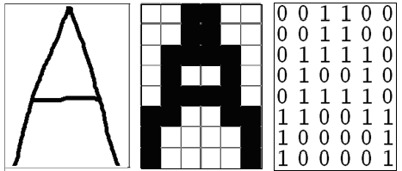
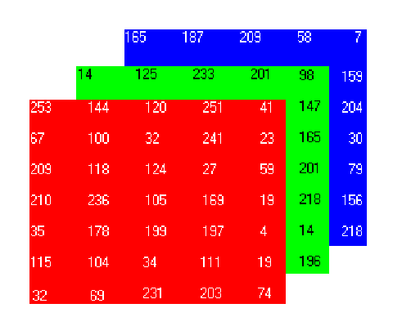
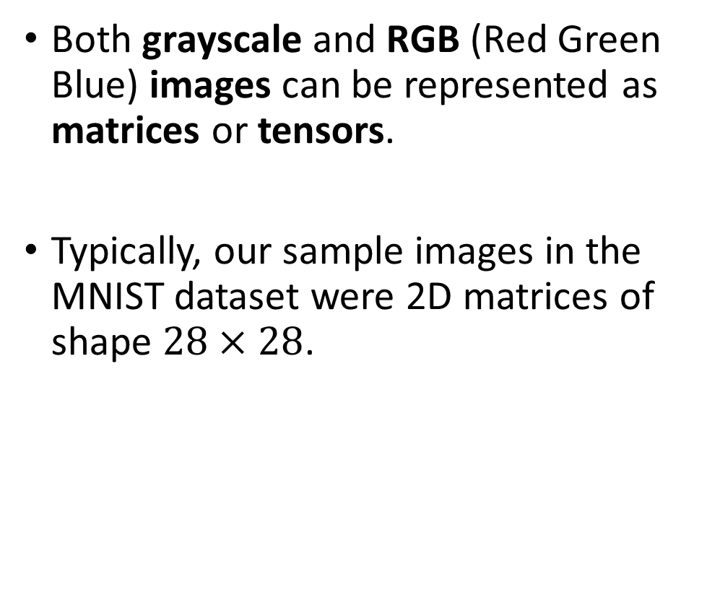
How to encode an image
Both grayscale and RGB (Red Green Blue) images can be represented as matrices or tensors.
Typically, our sample images in the MNIST dataset were 2D matrices of shape $28×28$.

Slide 13
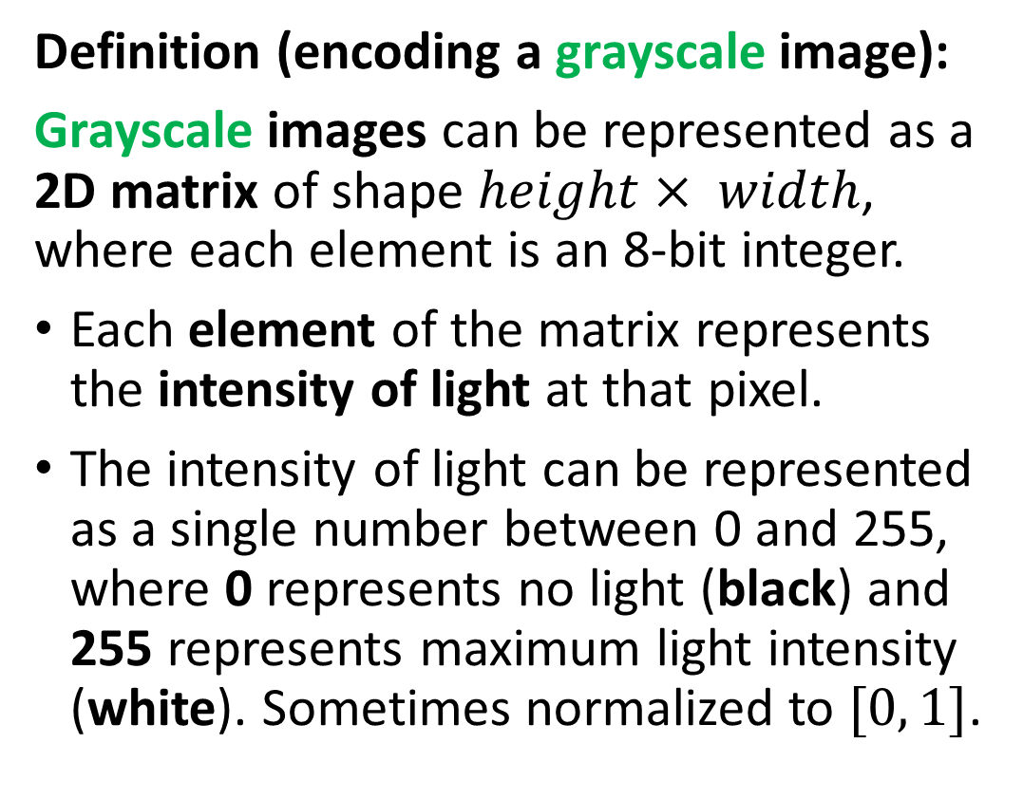
How to encode an image
Definition (encoding a grayscale image):
Grayscale images can be represented as a 2D matrix of shape $height× width$, where each element is an 8-bit integer.
Each element of the matrix represents the intensity of light at that pixel.
The intensity of light can be represented as a single number between 0 and 255, where 0 represents no light (black) and 255 represents maximum light intensity (white). Sometimes normalized to $[0, 1]$.

Slide 14
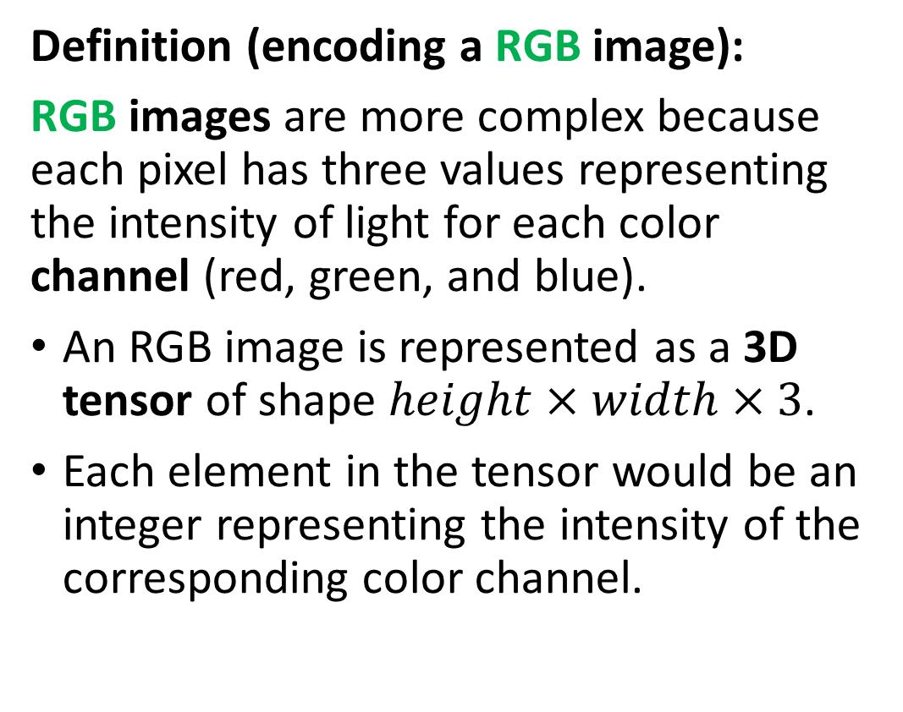
How to encode an image
Definition (encoding a RGB image):
RGB images are more complex because each pixel has three values representing the intensity of light for each color channel (red, green, and blue).
An RGB image is represented as a 3D tensor of shape $height×width×3$.
Each element in the tensor would be an integer representing the intensity of the corresponding color channel.

Slide 15
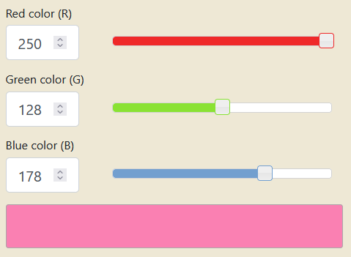
How to encode an image
Combining the red, green and blue values allows to generate any color. Try it!
https://www.rapidtables.com/convert/color/rgb-to-hex.html

Slide 16
The problem with images
Earlier, we played with apartment price prediction using surface (as the first input feature) and distance to MRT (as second input feature).
If I were to swap both input features (distance to MRT becomes first feature, and surface becomes second feature), a human would still be able to understand the information in inputs and predict prices.
But problem in the case of images: What happens if I randomly shuffle the pixels in all input images?
If we shuffled pixels, a human would not be able to tell the number in the image… Would this mean that we lost information about what is inside the image? Or, in other words, that the structure matters?

Slide 17
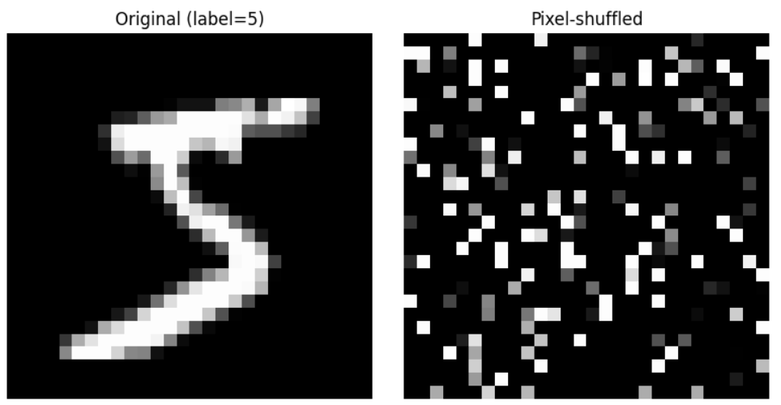
The problem with images
Earlier, we played with apartment price prediction using surface (as the first input feature) and distance to MRT (as second input feature).
If I were to swap both input features (distance to MRT becomes first feature, and surface becomes second feature), a human would still be able to understand the information in inputs and predict prices.
But problem in the case of images: What happens if I randomly shuffle the pixels in all input images?
If we shuffled pixels, a human would not be able to tell the number in the image… Would this mean that we lost information about what is inside the image? Or, in other words, that the structure matters?

Slide 18
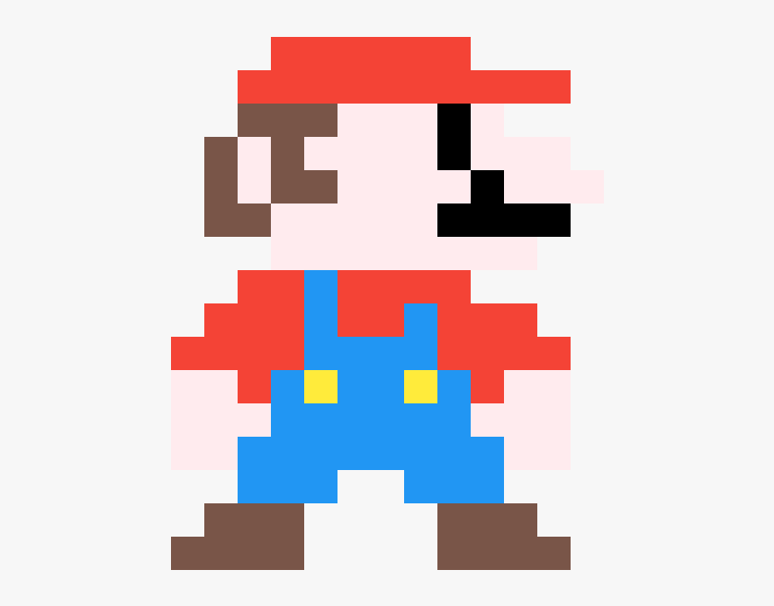
The problem with images: another example
Each element in a Greyscale matrix or RGB matrix corresponds to a pixel, representing something in the image.
The problem, however, is that it is often impossible to guess the meaning of a given pixel, by looking at this pixel alone.

Slide 19
The problem with images: another example
Can you guess what this pixel represents and what object it belongs to?
Flower petal
Piece of clothing
Skin of a human person
Feather of a bird

Slide 20
The problem with images: another example
What if I show you some neighbouring pixels now?
Flower petal
Piece of clothing
Skin of a human person
Feather of a bird

Slide 21
The problem with images: another example
What if I show you MORE neighbouring pixels now?
Flower petal
Piece of clothing
Skin of a human person
Feather of a bird

Slide 22
The problem with images: another example
What if I show you MORE neighbouring pixels now?
Flower petal
Piece of clothing
Skin of a human person
Feather of a bird

Slide 23
The spatial dependence property
Definition (the spatial dependence property of pixels):
The spatial dependence property of pixels states that the meaning or interpretation of a single pixel in an image can often only be understood in the context of the pixels around it.
This is because the information in a single pixel is often not enough to describe the complete picture, or even just the pixel itself.
The structure of the image (i.e. the relationship between a given pixel and its neighbouring pixels) is necessary to provide a full understanding of this particular pixel, or even the image as a whole.
Images have “structure” and this structure contains information, which is something we observed in the Mario pixel art example.

Slide 24
The homophily property
Definition (the homophily property of pixels):
Homophily in images refers to the phenomenon where pixels that are close to each other in the image tend to have similar properties (such as color, texture, or intensity).
For example, pixels that are close to each other and have a similar blue color can often be grouped together and be considered part of the sky region. Identifying parts of the image where the homophily property breaks (i.e. drastic changes in pixel color) is how we recognize objects in the image.
This property is a key factor in image processing and computer vision algorithms, as it provides a way to segment images into meaningful regions and perform tasks like object recognition and image classification.

Slide 25
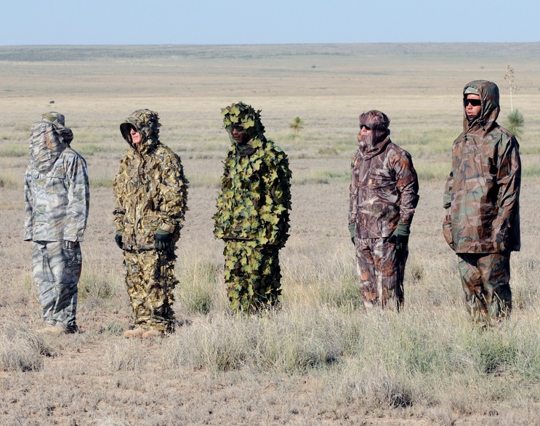
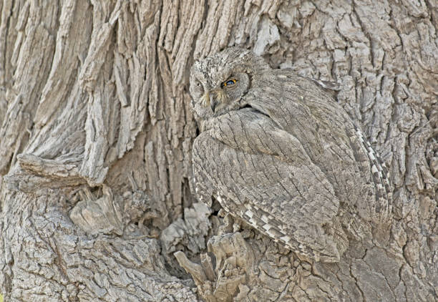
The homophily property
Note: The whole point of camouflage is to make it difficult to separate pixels from objects of interest and background, by having objects use similar colors as their backgrounds (i.e. homophily!)
Definition (the homophily property of pixels):
Homophily in images refers to the phenomenon where pixels that are close to each other in the image tend to have similar properties (such as color, texture, or intensity).
For example, pixels that are close to each other and have a similar blue color can often be grouped together and be considered part of the sky region. Identifying parts of the image where the homophily property breaks (i.e. drastic changes in pixel color) is how we recognize objects in the image.
This property is a key factor in image processing and computer vision algorithms, as it provides a way to segment images into meaningful regions and perform tasks like object recognition and image classification.

Slide 26
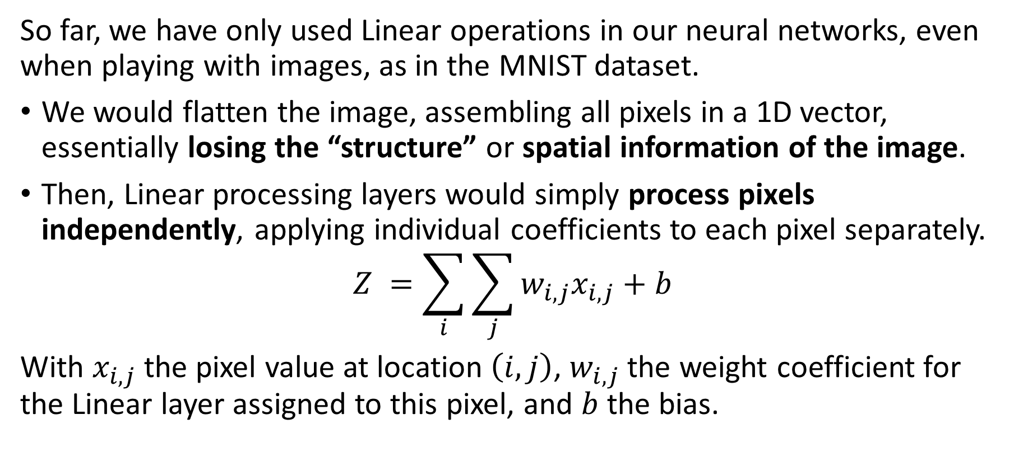
The problem with Linear processing
So far, we have only used Linear operations in our neural networks, even when playing with images, as in the MNIST dataset.
We would flatten the image, assembling all pixels in a 1D vector, essentially losing the “structure” or spatial information of the image.
Then, Linear processing layers would simply process pixels independently, applying individual coefficients to each pixel separately.
$$Z =\sum_{i}{\sum_{j}{w_{i,j}x_{i,j}+b}}$$
With $x_{i,j}$ the pixel value at location $\left(i,j\right)$, $w_{i,j}$ the weight coefficient for the Linear layer assigned to this pixel, and $b$ the bias.

Slide 27
The problem with Linear processing
Linear layers are not great at processing images because they do not take into account the spatial dependence of pixels.
Pixels in images are typically related to each other in a spatial manner, i.e. the meaning of a pixel depends on the neighbour pixels.
Unfortunately, linear models would assume each pixel is independent of the others and process them independently, which is not correct.
As a result, linear layers can miss important spatial relationships between pixels. This can, in turn, result in poor image representation and interpretation.
→ Need for a more specific processing operation for images, to use in place of the Linear one!

Slide 28
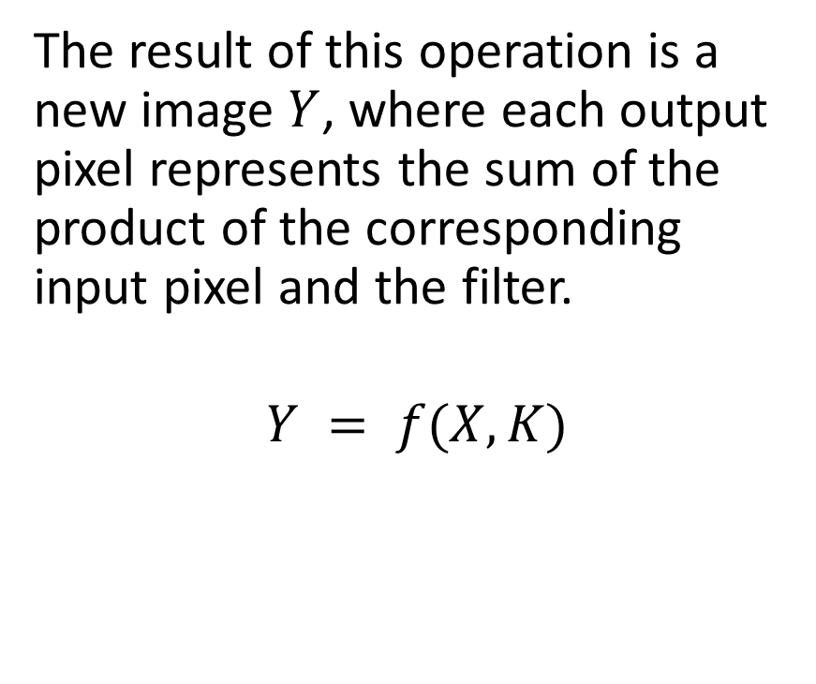
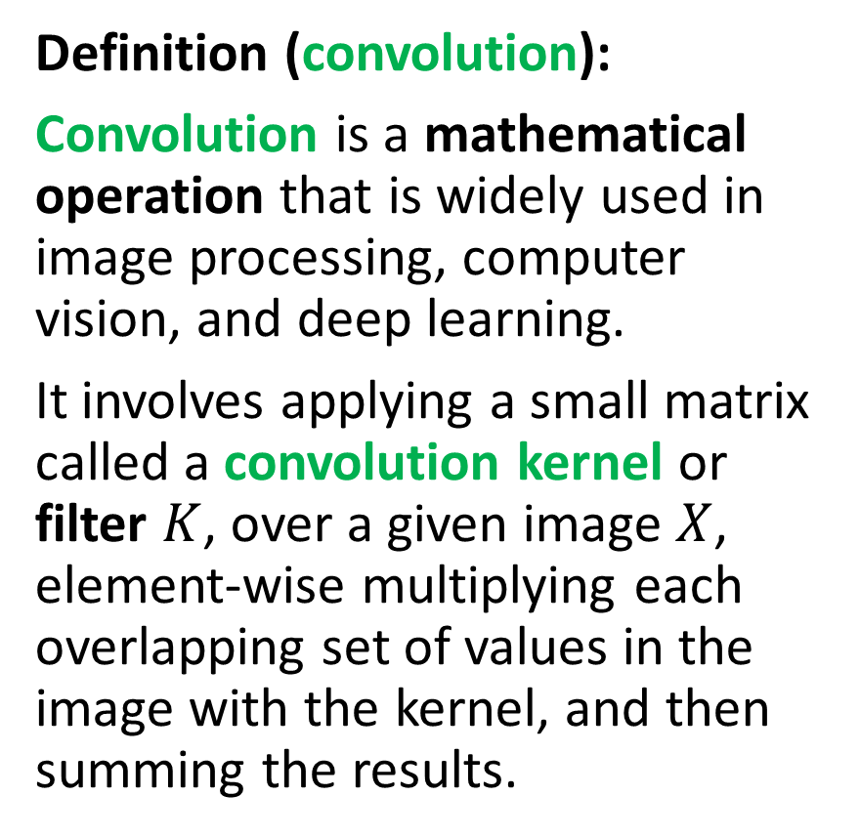
Introducing convolution!
Definition (convolution):
Convolution is a mathematical operation that is widely used in image processing, computer vision, and deep learning.
It involves applying a small matrix called a convolution kernel or filter $K$, over a given image $X$, element-wise multiplying each overlapping set of values in the image with the kernel, and then summing the results.
The result of this operation is a new image $Y$, where each output pixel represents the sum of the product of the corresponding input pixel and the filter.
$$Y = f(X, K)$$

Slide 29
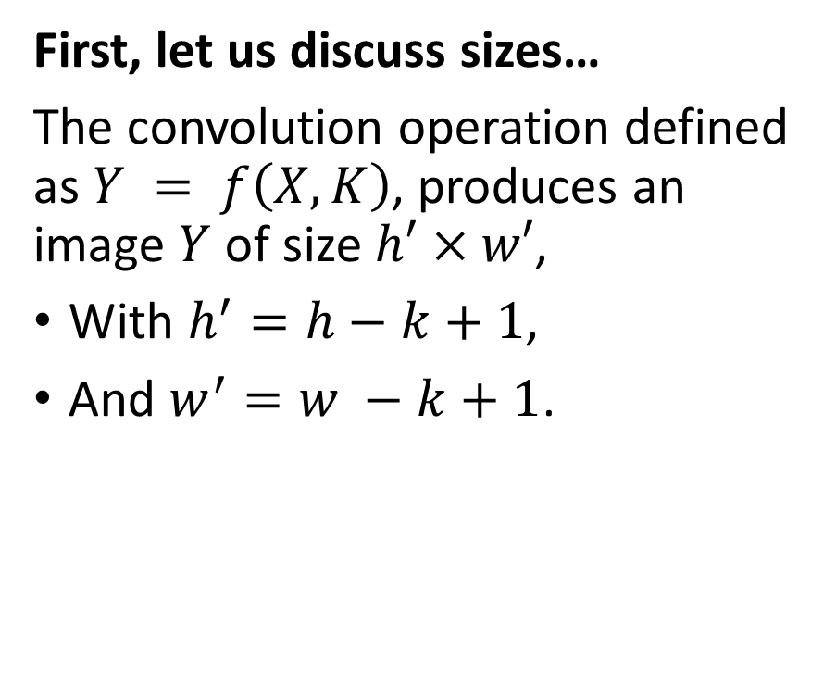
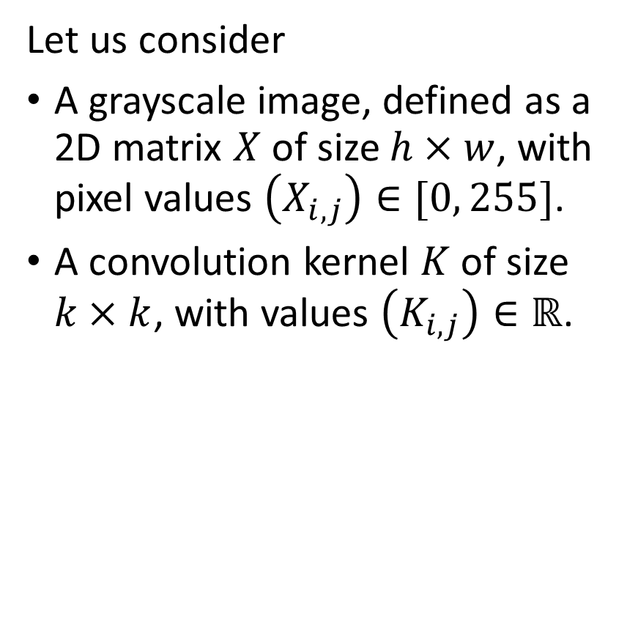
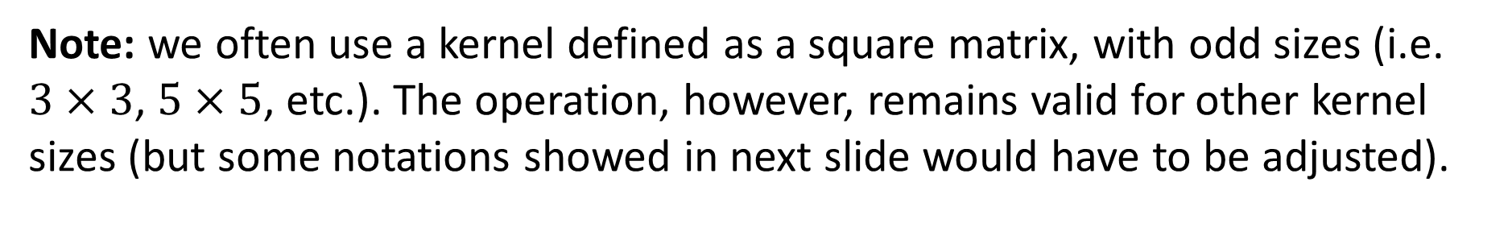
Introducing convolution!
Let us consider
A grayscale image, defined as a 2D matrix $X$ of size $h×w$, with pixel values $\left(X_{i,j}\right)∈[0, 255]$.
A convolution kernel $K$ of size $k×k$, with values $\left(K_{i,j}\right)∈ℝ$.
First, let us discuss sizes…
The convolution operation defined as $Y = f\left(X, K\right)$, produces an image $Y$ of size $h′×w′$,
With $h^{′}=h−k+1$,
And $w^{′}=w −k+1$.
Note: we often use a kernel defined as a square matrix, with odd sizes (i.e. $3×3$, $5×5$, etc.). The operation, however, remains valid for other kernel sizes (but some notations showed in next slide would have to be adjusted).

Slide 30

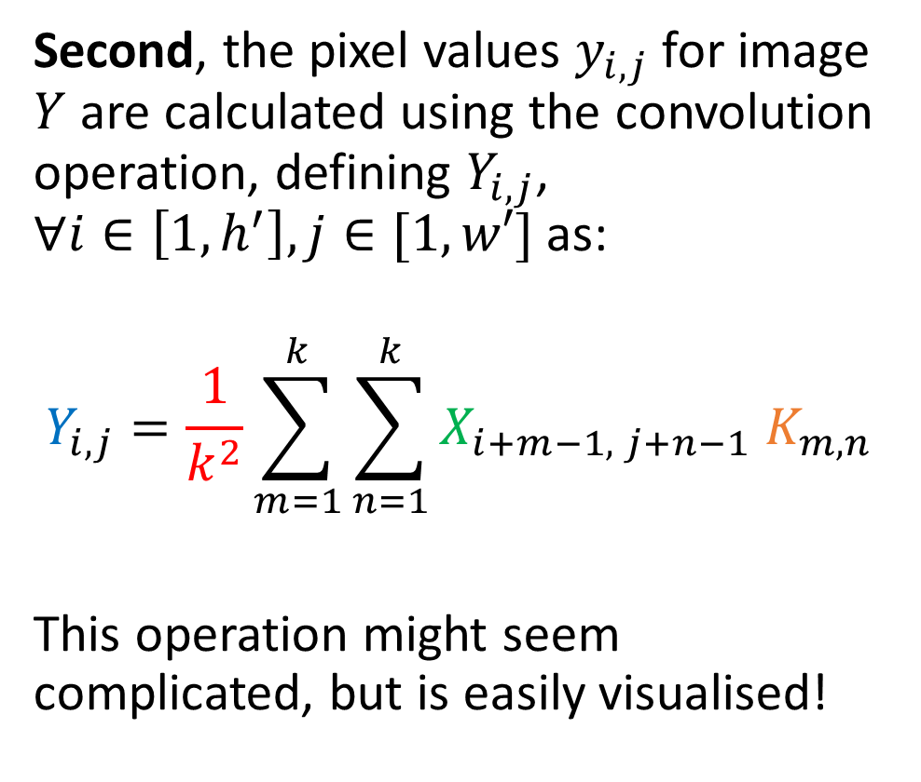


Introducing convolution!
1 | 2 | 4 | 2 | 1
4 | 7 | 3 | 2 | 1
4 | 5 | 2 | 3 | 1
2 | 1 | 7 | 8 | 4
3 | 2 | 4 | 7 | 8
X is 5 by 5
K is 3 by 3
Y is therefore 3 by 3.
(5-3+1 = 3)
$$X$$
Second, the pixel values $y_{i,j}$for image $Y$ are calculated using the convolution operation, defining $Y_{i,j}$, $∀i∈\left[1, h^{′}\right], j∈[1,w′]$ as:
$$Y_{i,j}=\frac{1}{k^{2}}\sum_{m=1}^{k}{\sum_{n=1}^{k}{X_{i+m−1, j+n−1} K_{m,n}}}$$
This operation might seem complicated, but is easily visualised!
1 | 0 | 1
0 | 2 | 1
1 | 0 | 1
$$K$$
… | … | …
… | … | …
… | … | …
$$Y$$

Slide 31
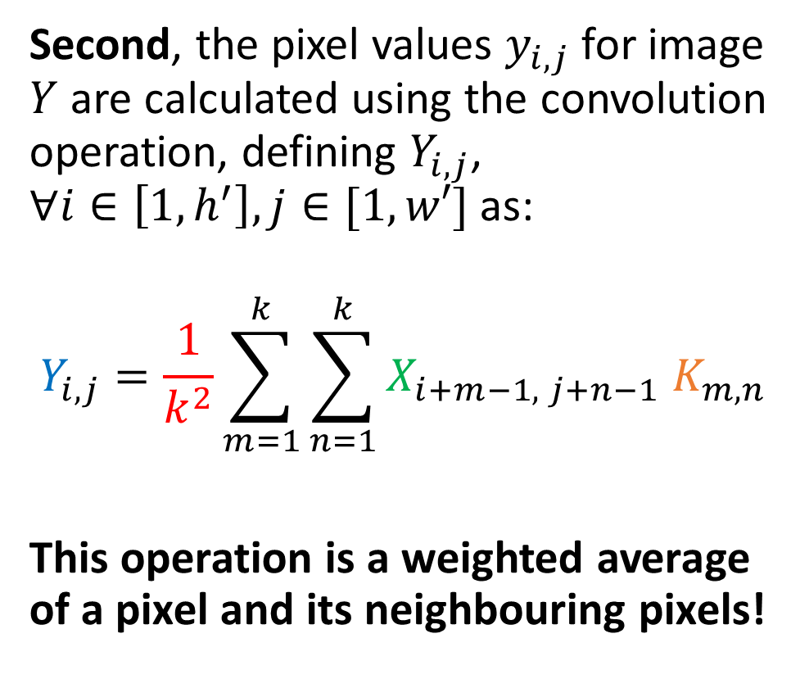
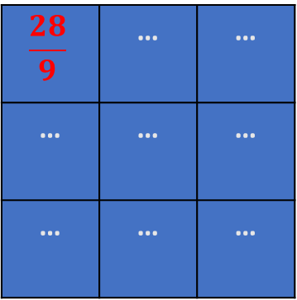
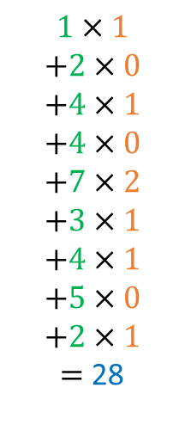
Introducing convolution!
1 | 2 | 4 | 2 | 1
4 | 7 | 3 | 2 | 1
4 | 5 | 2 | 3 | 1
2 | 1 | 7 | 8 | 4
3 | 2 | 4 | 7 | 8
$$1×1$$
$$+2×0$$
$$+4×1$$
$$+4×0$$
$$+7×2$$
$$+3×1$$
$$+4×1$$
$$+5×0$$
$$+2×1$$
$=$ 28
$$X$$
Second, the pixel values $y_{i,j}$for image $Y$ are calculated using the convolution operation, defining $Y_{i,j}$, $∀i∈\left[1, h^{′}\right], j∈[1,w′]$ as:
$$Y_{i,j}=\frac{1}{k^{2}}\sum_{m=1}^{k}{\sum_{n=1}^{k}{X_{i+m−1, j+n−1} K_{m,n}}}$$
This operation is a weighted average of a pixel and its neighbouring pixels!
1 | 0 | 1
0 | 2 | 1
1 | 0 | 1
$$K$$
$$\frac{28}{9}$$ | … | …
… | … | …
… | … | …
$$Y$$

Slide 32
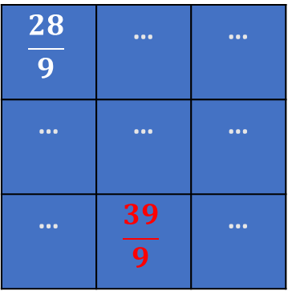
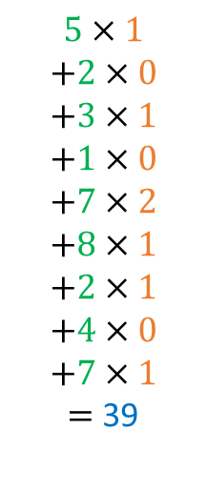
Introducing convolution!
1 | 2 | 4 | 2 | 1
4 | 7 | 3 | 2 | 1
4 | 5 | 2 | 3 | 1
2 | 1 | 7 | 8 | 4
3 | 2 | 4 | 7 | 8
$$5×1$$
$$+2×0$$
$$+3×1$$
$$+1×0$$
$$+7×2$$
$$+8×1$$
$$+2×1$$
$$+4×0$$
$$+7×1$$
$=$ 39
$$X$$
Second, the pixel values $y_{i,j}$for image $Y$ are calculated using the convolution operation, defining $Y_{i,j}$, $∀i∈\left[1, h^{′}\right], j∈[1,w′]$ as:
$$Y_{i,j}=\frac{1}{k^{2}}\sum_{m=1}^{k}{\sum_{n=1}^{k}{X_{i+m−1, j+n−1} K_{m,n}}}$$
This operation is a weighted average of a pixel and its neighbouring pixels!
1 | 0 | 1
0 | 2 | 1
1 | 0 | 1
$$K$$
$$\frac{28}{9}$$ | … | …
… | … | …
… | $$\frac{39}{9}$$ | …
$$Y$$

Slide 33

Introducing convolution!
1 | 2 | 4 | 2 | 1
4 | 7 | 3 | 2 | 1
4 | 5 | 2 | 3 | 1
2 | 1 | 7 | 8 | 4
3 | 2 | 4 | 7 | 8
$$5×1$$
$$+2×0$$
$$+3×1$$
$$+1×0$$
$$+7×2$$
$$+8×1$$
$$+2×1$$
$$+4×0$$
$$+7×1$$
$=$ 39
$$X$$
Second, the pixel values $y_{i,j}$for image $Y$ are calculated using the convolution operation, defining $Y_{i,j}$, $∀i∈\left[1, h^{′}\right], j∈[1,w′]$ as:
$$Y_{i,j}=\frac{1}{k^{2}}\sum_{m=1}^{k}{\sum_{n=1}^{k}{X_{i+m−1, j+n−1} K_{m,n}}}$$
1 | 0 | 1
0 | 2 | 1
1 | 0 | 1
$$K$$
$$\frac{28}{9}$$ | … | …
… | … | …
… | $$\frac{39}{9}$$ | …
$$Y$$
Note: Sometimes, the normalization term is removed and we may instead normalize the kernel (ensuring elements in kernel matrix sum up to 1), or not.

Slide 34
Introducing convolution!
1 | 2 | 4 | 2 | 1
4 | 7 | 3 | 2 | 1
4 | 5 | 2 | 3 | 1
2 | 1 | 7 | 8 | 4
3 | 2 | 4 | 7 | 8
$$5×1$$
$$+2×0$$
$$+3×1$$
$$+1×0$$
$$+7×2$$
$$+8×1$$
$$+2×1$$
$$+4×0$$
$$+7×1$$
$=$ 39
$$X$$
Second, the pixel values $y_{i,j}$for image $Y$ are calculated using the convolution operation, defining $Y_{i,j}$, $∀i∈\left[1, h^{′}\right], j∈[1,w′]$ as:
$$Y_{i,j}=\frac{1}{k^{2}}\sum_{m=1}^{k}{\sum_{n=1}^{k}{X_{i+m−1, j+n−1} K_{m,n}}}$$
1 | 0 | 1
0 | 2 | 1
1 | 0 | 1
$$K$$
$$\frac{28}{9}$$ | … | …
… | … | …
… | $$\frac{39}{9}$$ | …
$$Y$$
→ At the end of the day, convolution is just another type of matrix multiplication!

Slide 35
An animated visualisation of Convolution

Slide 36
Convolution and Image Processing courses
Convolution is a key mathematical operation that is widely used in computer vision and image processing to apply a wide range of transformations on an image (enhancing contrast, blurring, edge detection, Instagram filters, etc).
If Computer Vision is a direction that interests you, I would strongly advise to take a course on Image Processing (with implementations in OpenCV, Photoshop, etc.) during your continued learning.
For instance: https://www.udemy.com/course/digital-image-processing-from-ground-up-in-python/

Slide 37
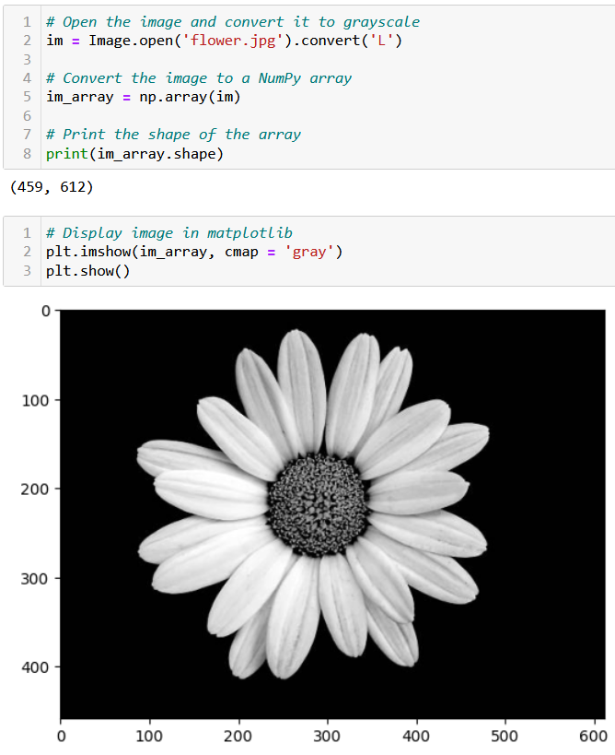
Testing convolution on images
Let us try the convolution operation on images to see their effect.
First, we need a greyscale image.

Slide 38
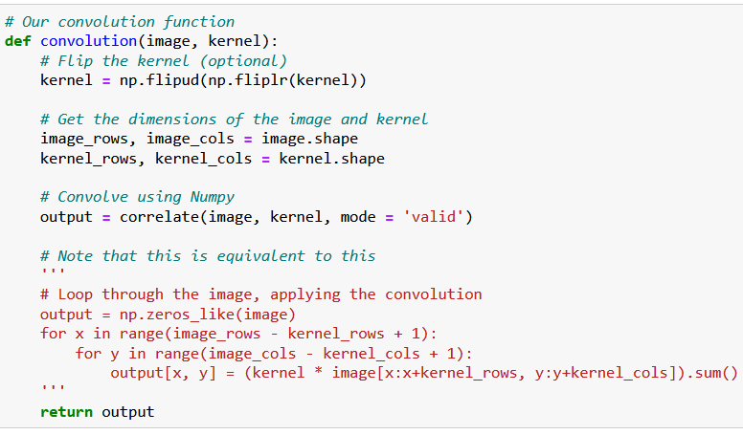
Testing convolution on images
Let us try the convolution operation on images to see their effect.
First, we need a greyscale image.
Second, we need a convolution function.

Slide 39
Testing convolution on images
What is the purpose of flipping the kernel?
Optional, but in short, flipping the kernel has mathematical and practical advantages that make it a common practice in deep learning.
(It has to do with commutativity, signal processing, the Fourier Transform and the convolution theorem, 100% out-of-scope).
https://stackoverflow.com/questions/45152473/why-is-the-convolutional-filter-flipped-in-convolutional-neural-networks

Slide 40
Testing convolution on images
Let us try the convolution operation on images to see their effect.
First, we need a greyscale image.
Second, we need a convolution function.
The magic for the transformation then happens when deciding which kernel to use.

Slide 41
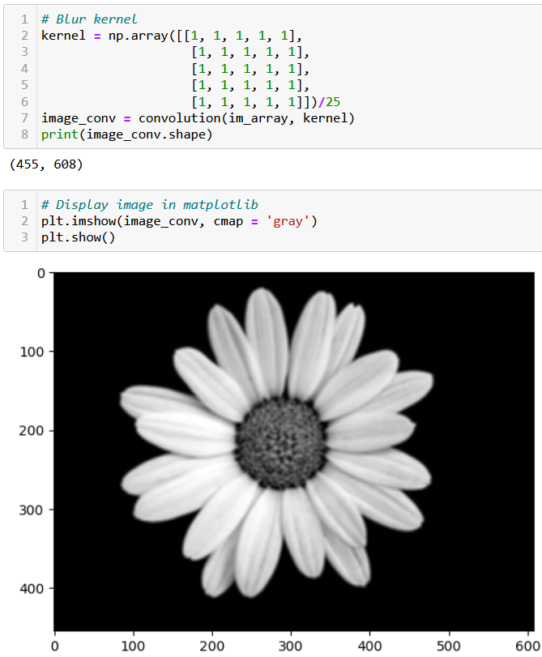
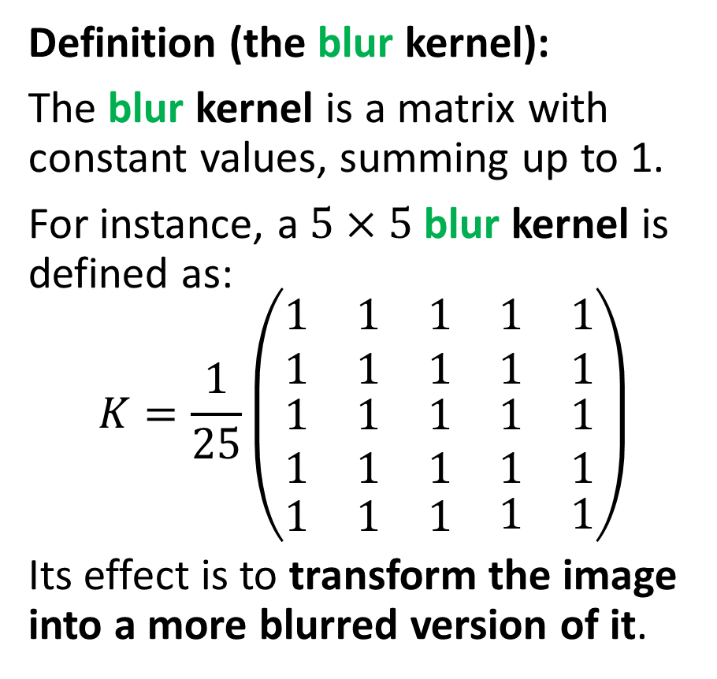
Testing convolution on images
Definition (the blur kernel):
The blur kernel is a matrix with constant values, summing up to 1.
For instance, a $5×5$ blur kernel is defined as:
$$K=\frac{1}{25}\left(\begin{matrix}\begin{matrix}1 & 1 & 1 \\ 1 & 1 & 1\end{matrix} & \begin{matrix}1 \\ 1\end{matrix} & \begin{matrix}1 \\ 1\end{matrix} \\ \begin{matrix}1 & 1 & 1 \\ 1 & 1 & 1\end{matrix} & \begin{matrix}1 \\ 1\end{matrix} & \begin{matrix}1 \\ 1\end{matrix} \\ \begin{matrix}1 & 1 & 1\end{matrix} & 1 & 1\end{matrix}\right)$$
Its effect is to transform the image into a more blurred version of it.

Slide 43
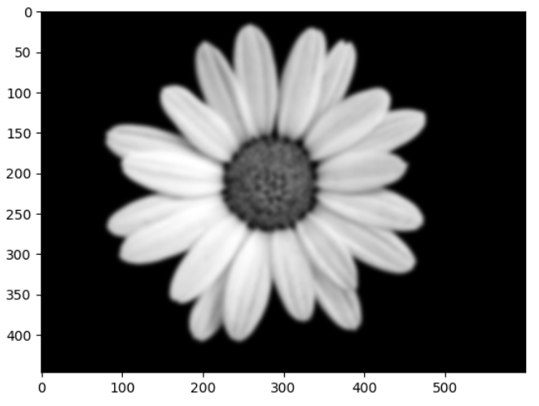
Can be repeated multiple times to increase the blur effect!

Slide 44
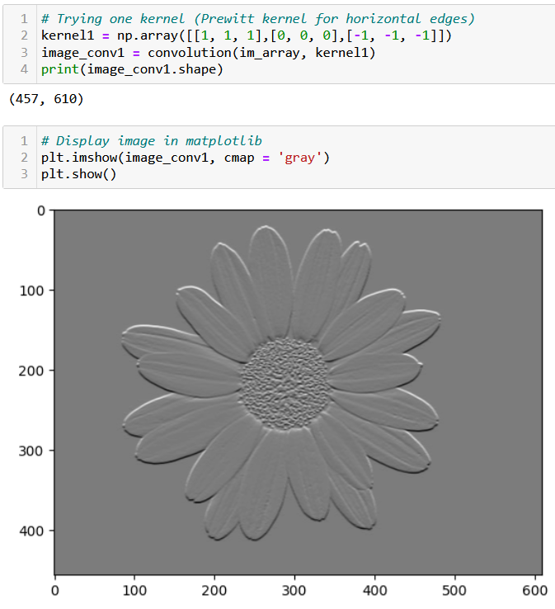
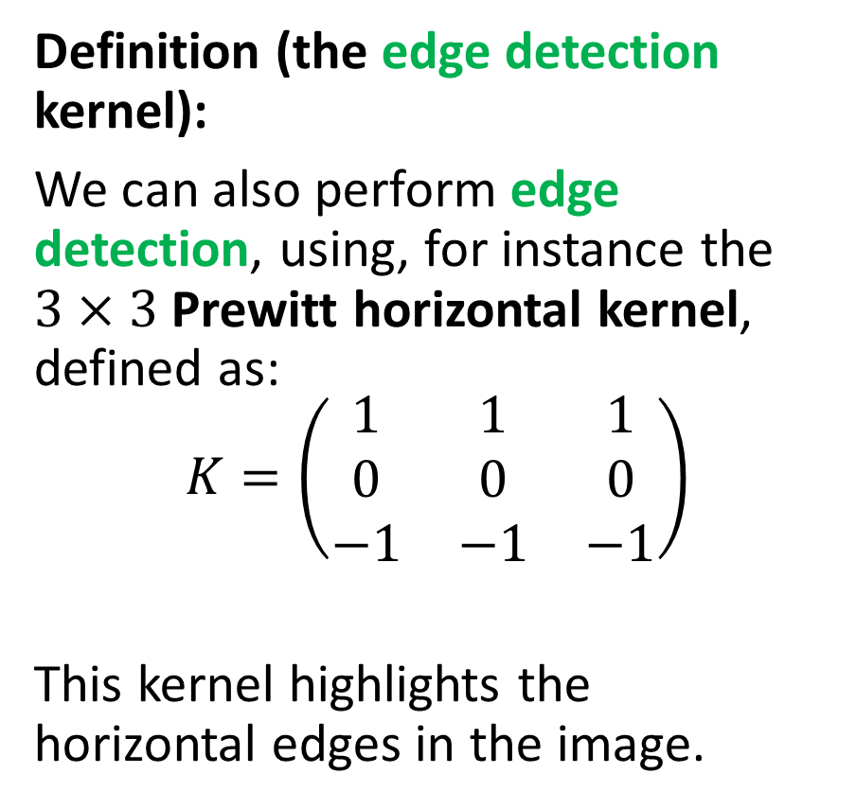
Testing convolution on images
Definition (the edge detection kernel):
We can also perform edge detection, using, for instance the $3×3$ Prewitt horizontal kernel, defined as:
$$K=\left(\begin{matrix}1 & 1 & 1 \\ 0 & 0 & 0 \\ −1 & −1 & −1\end{matrix}\right)$$
This kernel highlights the horizontal edges in the image.

Slide 45
Testing convolution on images
Definition (the edge detection kernel):
This kernel produces
a value close to zero when all pixels are similar,
and a non-zero value if there is a drastic change of values in the pixel and its neighbouring pixels.
Typically, it detects scenarios where the homophily property does not hold (i.e. an edge!).

Slide 47
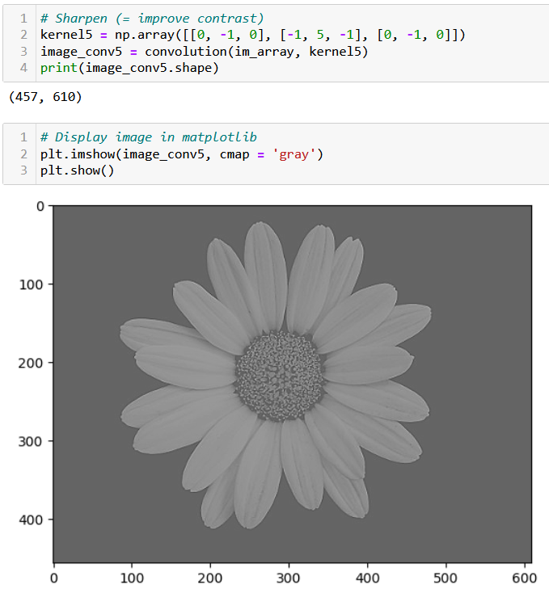
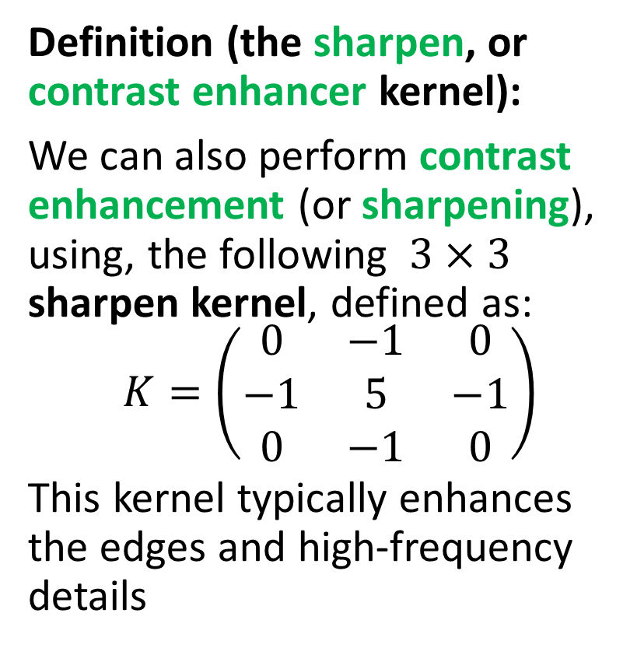
Testing convolution on images
Definition (the sharpen, or contrast enhancer kernel):
We can also perform contrast enhancement (or sharpening), using, the following $3×3$ sharpen kernel, defined as:
$$K=\left(\begin{matrix}0 & −1 & 0 \\ −1 & 5 & −1 \\ 0 & −1 & 0\end{matrix}\right)$$
This kernel typically enhances the edges and high-frequency details

Slide 49
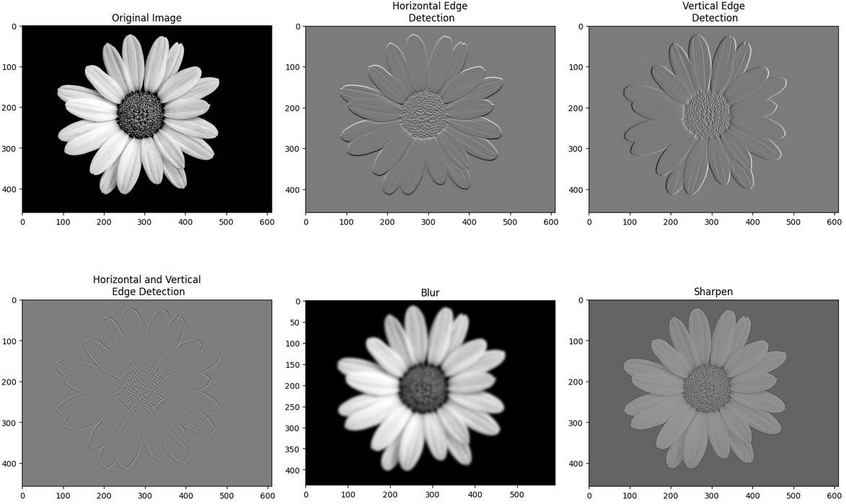
Many transformation kernels exist

Slide 50
More on convolution kernels and their effects

Slide 51
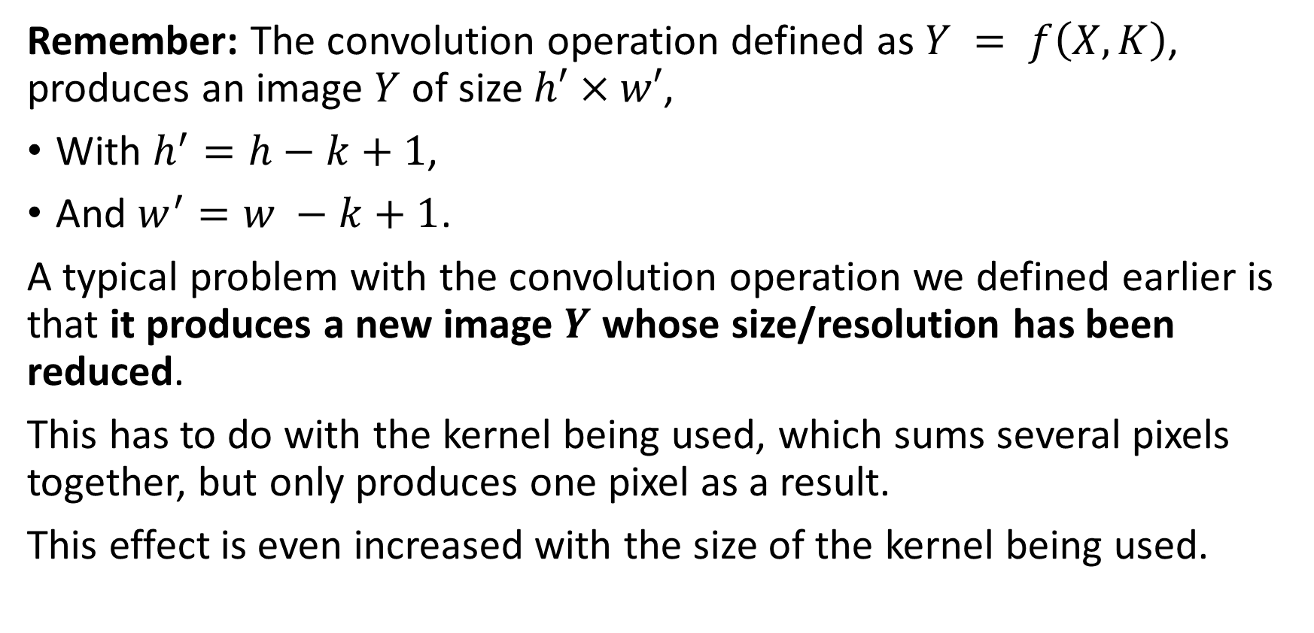
Downsizing
Remember: The convolution operation defined as $Y = f\left(X, K\right)$, produces an image $Y$ of size $h′×w′$,
With $h^{′}=h−k+1$,
And $w^{′}=w −k+1$.
A typical problem with the convolution operation we defined earlier is that it produces a new image $Y$ whose size/resolution has been reduced.
This has to do with the kernel being used, which sums several pixels together, but only produces one pixel as a result.
This effect is even increased with the size of the kernel being used.

Slide 52
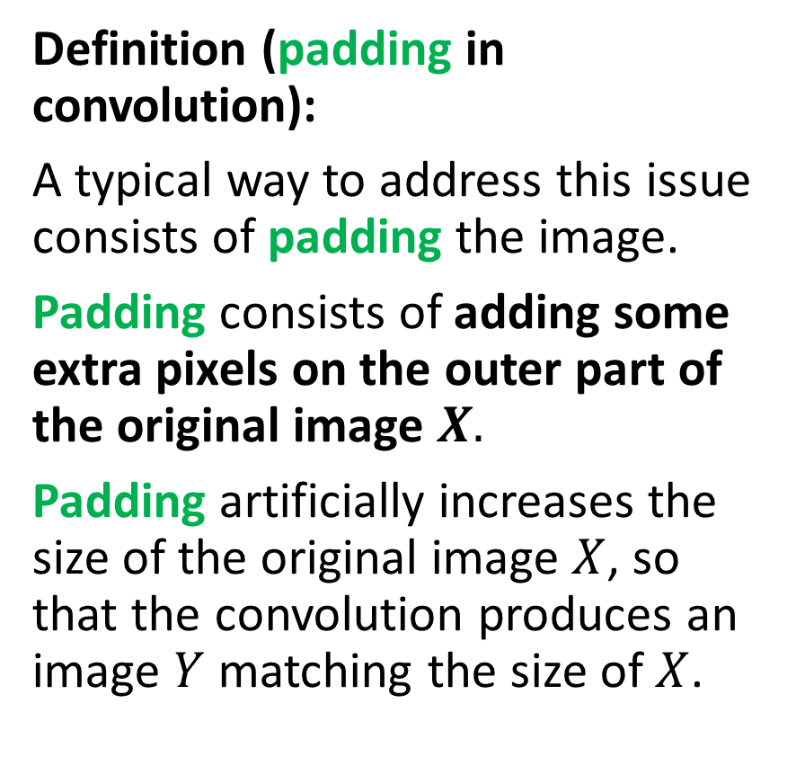
Adding some padding
Definition (padding in convolution):
A typical way to address this issue consists of padding the image.
Padding consists of adding some extra pixels on the outer part of the original image $X.$
Padding artificially increases the size of the original image $X$, so that the convolution produces an image $Y$ matching the size of $X$.
Three possible patterns for padding exist:
Valid/Same padding,
Zero padding,
Other types of padding…
This is typically be used to maintain the spatial dimensions of the input image and prevent the spatial dimensions of the output from getting too small.

Slide 53




Adding some padding
Valid padding: default configuration, no padding is applied to the input data. The convolution operation is only performed only on the valid parts of the input and the output size is then smaller than the input size.
$$Y = f(X, K)$$
$$K$$
$$Y$$
$$X$$

Slide 54

Adding some padding
Same padding: The number of elements added to the image (i.e. padding size $p$) is defined so that image $Y$ has the same size as $X$.
Zero padding: added pixels can simply be set to have the value 0.
0 | 0 | 0 | 0 | 0 | 0 | 0
0 |  |  |  |  |  | 0
0 |  |  |  |  |  | 0
0 |  |  |  |  |  | 0
0 |  |  |  |  |  | 0
0 |  |  |  |  |  | 0
0 | 0 | 0 | 0 | 0 | 0 | 0
$$Y = f(X, K)$$
$$K$$
$$Y$$
$$X$$

Slide 55
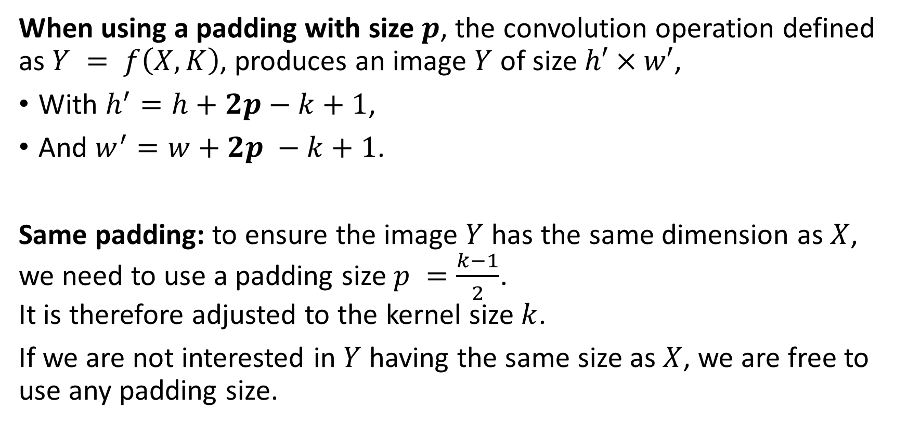
Adding some padding
When using a padding with size $p$, the convolution operation defined as $Y = f\left(X, K\right)$, produces an image $Y$ of size $h′×w′$,
With $h^{′}=h+2p−k+1$,
And $w^{′}=w+2p −k+1$.
Same padding: to ensure the image $Y$ has the same dimension as $X$, we need to use a padding size $p =\frac{k−1}{2}$. It is therefore adjusted to the kernel size $k$.
If we are not interested in $Y$ having the same size as $X$, we are free to use any padding size.

Slide 56

Adding some padding
Interpolation padding: instead of zeros, added pixels have the value of the closest pixel. Can also “zoom in” the original image and resize it to the expected number of pixels we want for image $X$ after padding.
1 | 1 | 5 | 5 | 2 | 4 | 4
1 | 1 | 5 | 5 | 2 | 4 | 4
2 | 2 | 4 | 5 | 2 | 2 | 2
3 | 3 | 1 | 1 | 1 | 1 | 1
4 | 4 | 4 | 7 | 2 | 3 | 3
5 | 5 | 0 | 0 | 3 | 1 | 1
5 | 5 | 0 | 0 | 3 | 1 | 1
$$Y = f(X, K)$$
$$K$$
$$Y$$
$$X$$

Slide 57
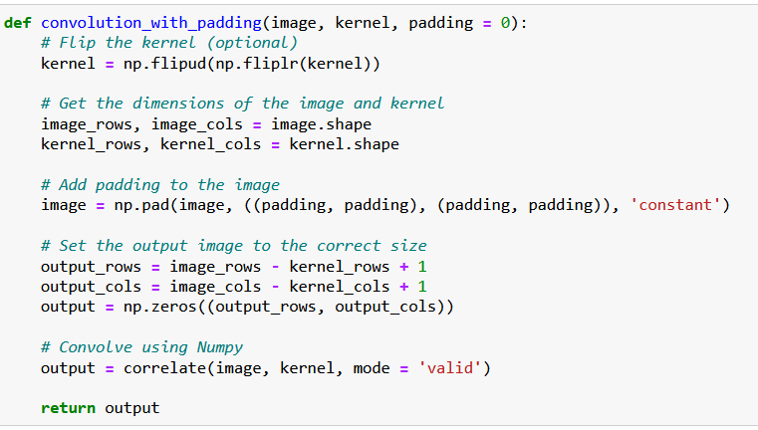
Adding some padding
0 | 0 | 0 | 0 | 0 | 0 | 0
0 |  |  |  |  |  | 0
0 |  |  |  |  |  | 0
0 |  |  |  |  |  | 0
0 |  |  |  |  |  | 0
0 |  |  |  |  |  | 0
0 | 0 | 0 | 0 | 0 | 0 | 0
Padding is simply implemented using the pad() function.
It adds a layer of zeroes to the matrix image, of size padding on top, bottom, right and left side of the image matrix.

Slide 58
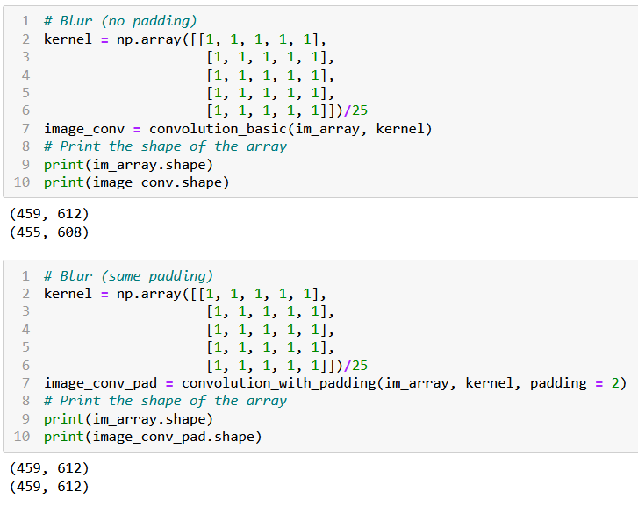
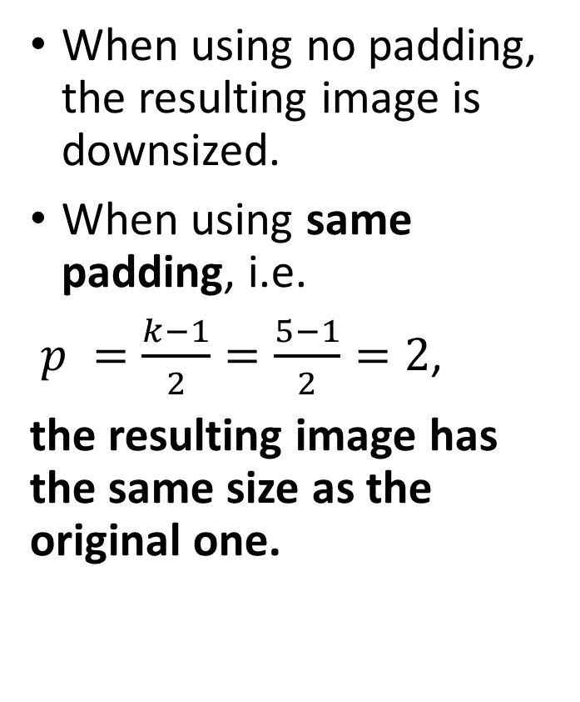
Adding some padding
When using no padding, the resulting image is downsized.
When using same padding, i.e.
$p =\frac{k−1}{2}=\frac{5−1}{2}=2$,
the resulting image has the same size as the original one.

Slide 59
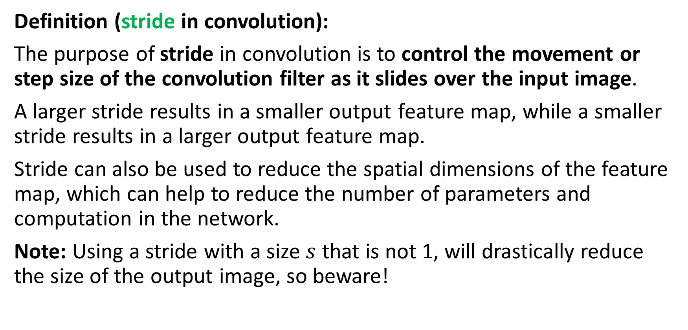
Adding a stride
Definition (stride in convolution):
The purpose of stride in convolution is to control the movement or step size of the convolution filter as it slides over the input image.
A larger stride results in a smaller output feature map, while a smaller stride results in a larger output feature map.
Stride can also be used to reduce the spatial dimensions of the feature map, which can help to reduce the number of parameters and computation in the network.
Note: Using a stride with a size $s$ that is not 1, will drastically reduce the size of the output image, so beware!

Slide 60

Adding a stride
Below, we demonstrate what a stride of size $s = 2$does (no padding).
First, use the convolution as before, next elements to be used are “two steps” away from the first position, and so on.
1 | 1 | 5 | 5 | 2 | 4 | 4
1 | 1 | 5 | 5 | 2 | 4 | 4
2 | 2 | 4 | 5 | 2 | 2 | 2
3 | 3 | 1 | 1 | 1 | 1 | 1
4 | 4 | 4 | 7 | 2 | 3 | 3
5 | 5 | 0 | 0 | 3 | 1 | 1
5 | 5 | 0 | 0 | 0 | 1 | 1
…
$$Y = f(X, K)$$
$$K$$
$$Y$$
$$X$$

Slide 61
Adding a stride
Below, we demonstrate what a stride of size $s = 2$does (no padding).
First, use the convolution as before, next elements to be used are “two steps” away from the first position, and so on.
1 | 1 | 5 | 5 | 2 | 4 | 4
1 | 1 | 5 | 5 | 2 | 4 | 4
2 | 2 | 4 | 5 | 2 | 2 | 2
3 | 3 | 1 | 1 | 1 | 1 | 1
4 | 4 | 4 | 7 | 2 | 3 | 3
5 | 5 | 0 | 0 | 3 | 1 | 1
5 | 5 | 0 | 0 | 0 | 1 | 1
… | …
$$Y = f(X, K)$$
$$K$$
$$Y$$
$$X$$

Slide 62
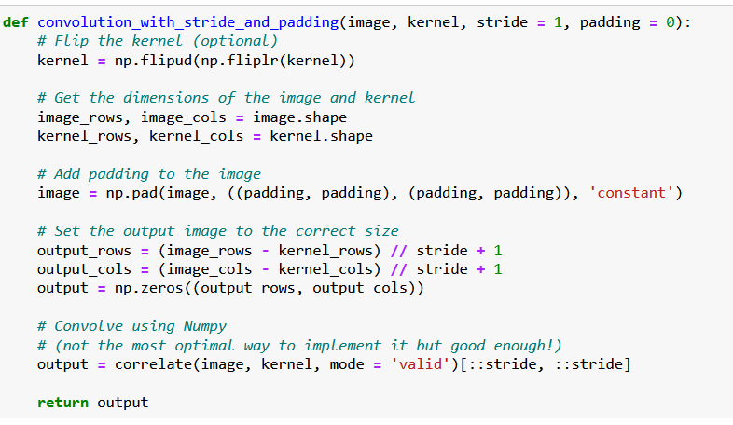
Adding a stride
Stride is easily implemented by using a slicing in the result of the correlation.
This is not the most optimized way to do it, however!
(We do not care so much, as we will use the PyTorch version of convolution after this!)

Slide 63
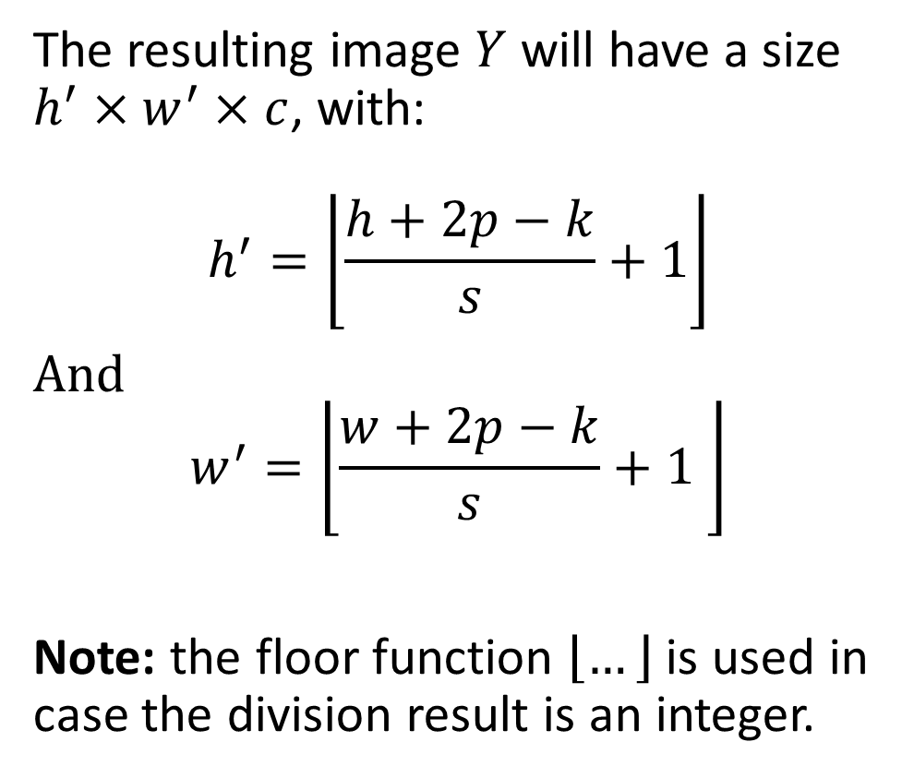
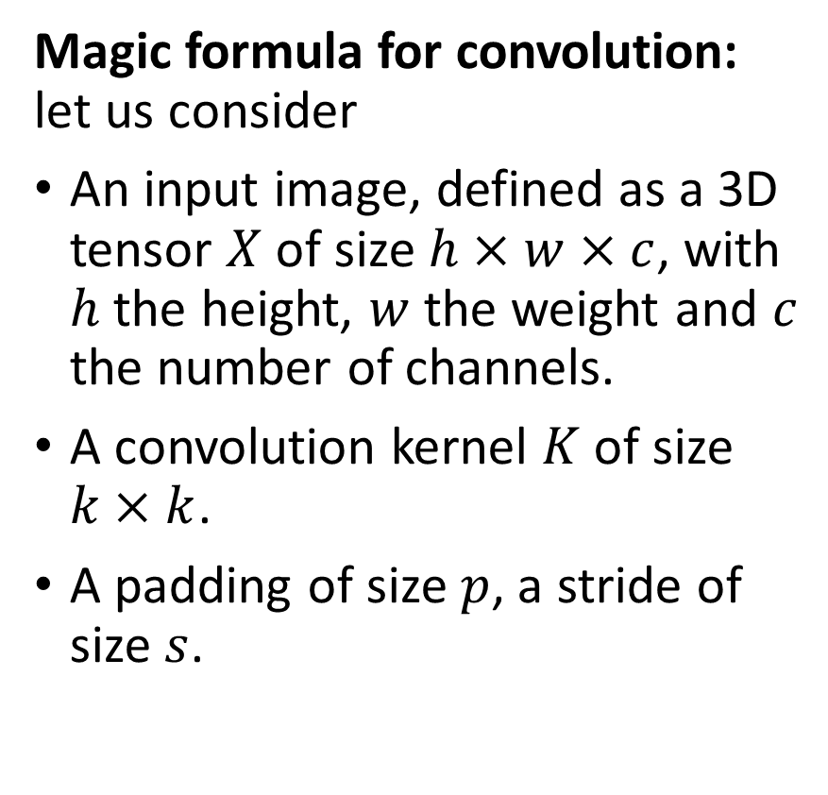
The (final) magic formula for convolution
Magic formula for convolution: let us consider
An input image, defined as a 3D tensor $X$ of size $h×w×c$, with $h$ the height, $w$ the weight and $c$ the number of channels.
A convolution kernel $K$ of size $k×k$.
A padding of size $p$, a stride of size $s$.
The resulting image $Y$ will have a size $h^{′}×w^{′}×c$, with:
$$h^{′}=\left\lfloor \frac{h+2p−k}{s}+1\right\rfloor$$
And $$w^{′}=\left\lfloor \frac{w+2p−k}{s}+1 \right\rfloor$$
Note: the floor function $\left\lfloor …\right\rfloor$ is used in case the division result is an integer.

Slide 64
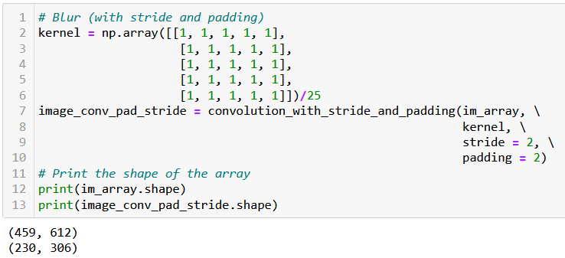

Adding a stride
$$h^{′}=\left\lfloor \frac{h+2p−k}{s}+1\right\rfloor$$
$$h′=\left\lfloor \frac{459+2×2−5}{2}+1\right\rfloor =230$$

Slide 65

Adding a dilation
Definition (dilation in convolution):
Dilation in image convolution determines the spacing between the values of the original image multiplying the kernel.
By default, the value for dilation is $d = 1.$
With a dilation greater than 1, the pixel values of the original image multiplying the kernel are spread apart by a specified number of pixels.
This is a very niche feature of the convolution operation. It is easier to visualise it than explain it.
(We leave its implementation as practice to the reader.)

Slide 66

Adding a dilation
Below, we demonstrate what a dilation of size $d = 2$does. Our convolution uses a stride with default value set to 1, padding is also set to its default value 0. Elements being computed together at then “2 steps away” from each other.
1 | 1 | 5 | 5 | 2 | 4 | 4
1 | 1 | 5 | 5 | 2 | 4 | 4
2 | 2 | 4 | 5 | 2 | 2 | 2
3 | 3 | 1 | 1 | 1 | 1 | 1
4 | 4 | 4 | 7 | 2 | 3 | 3
5 | 5 | 0 | 0 | 3 | 1 | 1
5 | 5 | 0 | 0 | 0 | 1 | 1
…
$$Y = f(X, K)$$
$$K$$
$$Y$$
$$X$$

Slide 67


The (final) magic formula for convolution
Magic formula for convolution version 2.0: let us consider
An input image, defined as a 3D tensor $X$ of size $h×w×c$, with $h$ the height, $w$ the weight and $c$ the number of channels.
A convolution kernel $K$ of size $k×k$.
A padding of size $p$, a stride of size $s$, and a dilation of size $d$.
The resulting image $Y$ will have a size $h^{′}×w^{′}×c$, with:
$$h^{′}=\left\lfloor \frac{h+2p−d\left(k−1\right)−1}{s}+1\right\rfloor$$
And $$w^{′}=\left\lfloor \frac{w+2p−d\left(k−1\right)−1}{s}+1 \right\rfloor$$
Note: the floor function $\left\lfloor …\right\rfloor$ is used in case the division result is an integer.

Slide 68

Implementing a custom Conv in PyTorch (with stride and padding, no dilation)

Slide 69

Implementing a custom Conv in PyTorch (with stride and padding, no dilation)
The PyTorch and the Numpy implementations are indeed equivalent.

Slide 70

The Conv2d in PyTorch
PyTorch has a Conv2d function implementing said convolution.
We will rely on it from now on.

Slide 71
The Conv2d in PyTorch
Note, however that this layer has two trainable parameters:
Weight (which is our kernel, whose values will be decided later during training).
Bias (which was not there before?)

Slide 72

The Conv2d in PyTorch
Note, however that this layer has two trainable parameters:
Weight (which is our kernel, whose values will be decided later during training).
Bias (which was not there before?)
Bias is simply added to our convolution operation, following the intuition of the $WX + b$operation from earlier.
$$Y_{i,j}=\frac{1}{k^{2}}\sum_{m=1}^{k}{\sum_{n=1}^{k}{X_{i+m−1, j+n−1} K_{m,n}}}+b$$

Slide 73
Let us call it a break for now
We will continue on the next lecture with our PyTorch implementation of the convolution operation and our first Convolutional Neural Network.

